Slide 1




NEXT GEN EMPLOYABILITY PROGRAM
Creating a future-ready workforce
Team Members
College Name
Student Name : Hariprathap A
Student ID : 622021104032
Paavai College of Engineering

Slide 2

CAPSTONE PROJECT SHOWCASE
Project Title
Building Bus Reservation System using Python and Django
Abstract | Problem Statement | Project Overview | Proposed Solution | Technology Used | Modelling & Results | Conclusion

Slide 3
Abstract : SwiftRide - Your Ultimate Online Bus Ticket Reservation System
"SwiftRide" is an innovative online bus ticket reservation system developed using Python and Django framework. With the ever-growing demand for efficient transportation services, SwiftRide aims to revolutionize the way people book bus tickets, providing users with a seamless and convenient experience.
The system leverages the power of Python and Django to offer a robust, scalable, and user-friendly platform for booking bus tickets. Through intuitive interfaces and advanced features, SwiftRide simplifies the ticket reservation process, enabling users to search for available routes, select preferred seats, and make secure payments with ease.
Key functionalities of SwiftRide include real-time availability updates, flexible payment options, interactive seat selection, and instant confirmation of bookings. Additionally, the system ensures a responsive and accessible design, allowing users to access the platform from any device, anywhere, at any time.
Behind the scenes, SwiftRide utilizes Django's powerful MVC architecture, ORM capabilities, and built-in security features to ensure data integrity, scalability, and protection against common web vulnerabilities. Python's versatility and readability further enhance development productivity, enabling seamless integration of new features and functionalities.
In summary, SwiftRide stands as the ultimate solution for individuals seeking hassle-free online bus ticket reservations. By harnessing the capabilities of Python and Django, SwiftRide sets a new standard for efficiency, convenience, and reliability in the transportation industry.
Source : Python and Django Documentation

Slide 4
Problem Statement
Despite advancements in technology, the process of booking bus tickets often remains cumbersome and time-consuming for travelers. Existing online ticket reservation systems often lack user-friendly interfaces, real-time updates, and seamless payment options, leading to frustration and inconvenience for users.
In response to these challenges, there is a pressing need for a modern, innovative online bus ticket reservation system that addresses the shortcomings of existing solutions. This system should offer a seamless booking experience, provide real-time availability updates, support flexible payment options, and prioritize user security and data integrity.
To bridge this gap, the proposed solution, "SwiftRide," leverages the capabilities of Python and the Django framework to deliver a cutting-edge online bus ticket reservation platform. SwiftRide aims to revolutionize the way people book bus tickets by offering a user-friendly interface, robust backend architecture, and advanced features that enhance convenience, accessibility, and security for travelers.
The problem statement thus revolves around the inefficiencies and limitations of current online ticket reservation systems and the need for a modern solution that leverages Python and Django to deliver a superior booking experience for users.
Source : Python and Django Documentation

Slide 5
Project Overview
SwiftRide is an innovative online bus ticket reservation system developed using Python and the Django framework. The project aims to streamline the process of booking bus tickets by providing users with a user-friendly platform that offers real-time updates, flexible payment options, and enhanced security features.
Key Features:
1. User-friendly Interface
2. Real-time Availability Updates
3. Flexible Payment Options
4. Interactive Seat Selection
5. Instant Confirmation
6. Responsive Design
7. Security and Data Integrity
SwiftRide aims to revolutionize the online bus ticket reservation experience by providing a modern, efficient, and secure platform that meets the needs of today's travelers. With its user-friendly interface, real-time updates, and robust security measures, SwiftRide sets a new standard for online ticket reservation systems, enhancing convenience and reliability for users.
Source : Python and Django Documentation
:

Slide 6
Proposed Solution
.
To address the challenges outlined in the problem statement, we propose the development of SwiftRide, an innovative online bus ticket reservation system built using Python and Django. SwiftRide aims to revolutionize the way people book bus tickets by providing a modern, efficient, and user-friendly platform that prioritizes convenience, accessibility, and security.
Key Features and Components:
User-Friendly Interface: SwiftRide will feature an intuitive and easy-to-navigate interface, allowing users to search for available routes, select preferred seats, and complete bookings with minimal effort.
Real-Time Updates: The system will provide real-time updates on bus availability, ensuring that users have access to accurate and up-to-date information at all times.
Flexible Payment Options: SwiftRide will support a variety of secure payment options, including credit/debit cards, mobile wallets, and net banking, giving users the flexibility to choose the payment method that best suits their needs.
Interactive Seat Selection: Users will be able to choose their preferred seats from an interactive seating chart, providing them with a personalized and comfortable travel experience.
Instant Confirmation: Upon completing a booking, users will receive instant confirmation via email or SMS, along with detailed information about their reservation and journey itinerary.
Source : Python and Django Documentation

Slide 7
Implementation Approach:
Frontend Development: The frontend of SwiftRide will be developed using HTML, CSS, and JavaScript, ensuring a visually appealing and interactive user interface.
Backend Development: The backend of SwiftRide will be built using Python and the Django framework, leveraging Django's built-in features for rapid development and scalability.
Database Management: The system will utilize a relational database management system (e.g., PostgreSQL) to store user data, reservation details, and other relevant information.
Testing and Quality Assurance: Rigorous testing and quality assurance procedures will be conducted throughout the development process to ensure that SwiftRide meets the highest standards of reliability, usability, and security.
Deployment and Maintenance: Once development is complete, SwiftRide will be deployed to a secure and reliable hosting environment, with ongoing maintenance and support to ensure continued performance and reliability.
In summary, SwiftRide offers a comprehensive solution to the challenges faced by existing online bus ticket reservation systems, providing users with a modern, efficient, and secure platform for booking bus tickets with ease.
Source : Python and Django Documentation

Slide 8


Technology Used
Front-end
Back-end
Source : Python and Django Documentation

Slide 9
Modelling & Results
Database Schema Design: This includes the modeling of database tables, their relationships, and attributes.
User Interface Mockups: These are visual representations of the user interface, showcasing the design and layout of key screens and functionalities.
System Flow Diagram: This illustrates the flow of interactions within the SwiftRide system, including user actions and system responses.
Prototype Demo: A demo of the SwiftRide prototype, showcasing its key features and functionalities.
The SwiftRide system provides a user-friendly platform for booking bus tickets online, enhancing convenience and accessibility for users.
Real-time updates on bus availability and interactive seat selection improve the booking experience.
Flexible payment options and instant confirmation enhance user satisfaction and trust in the system.
The system prioritizes security and data integrity, ensuring the protection of user information and transactions.
Source : Python and Django Documentation

Slide 10
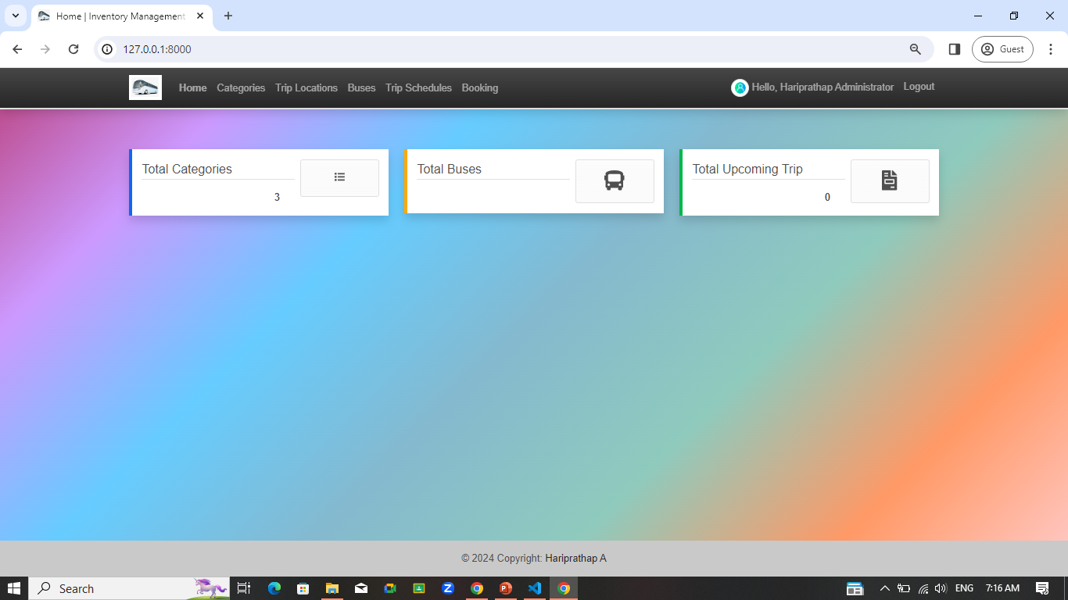
Homepage

Slide 11
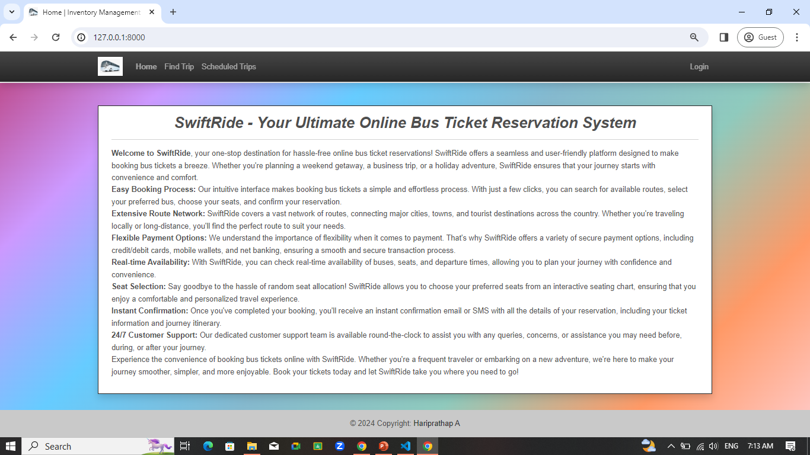
About-Us-Page

Slide 12
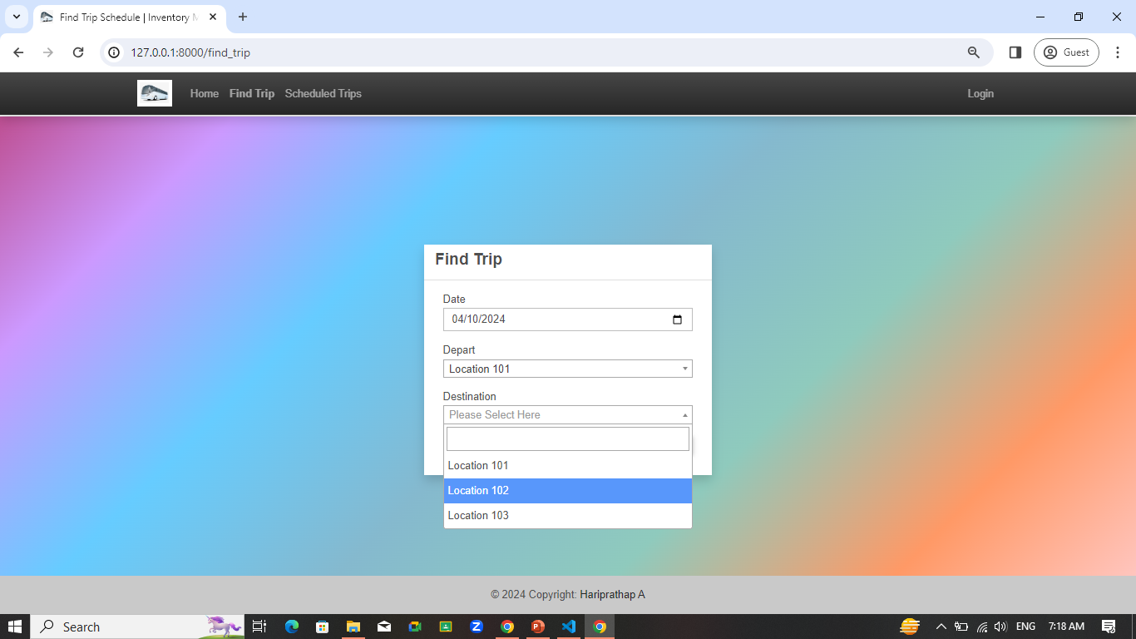
Service-Page

Slide 13
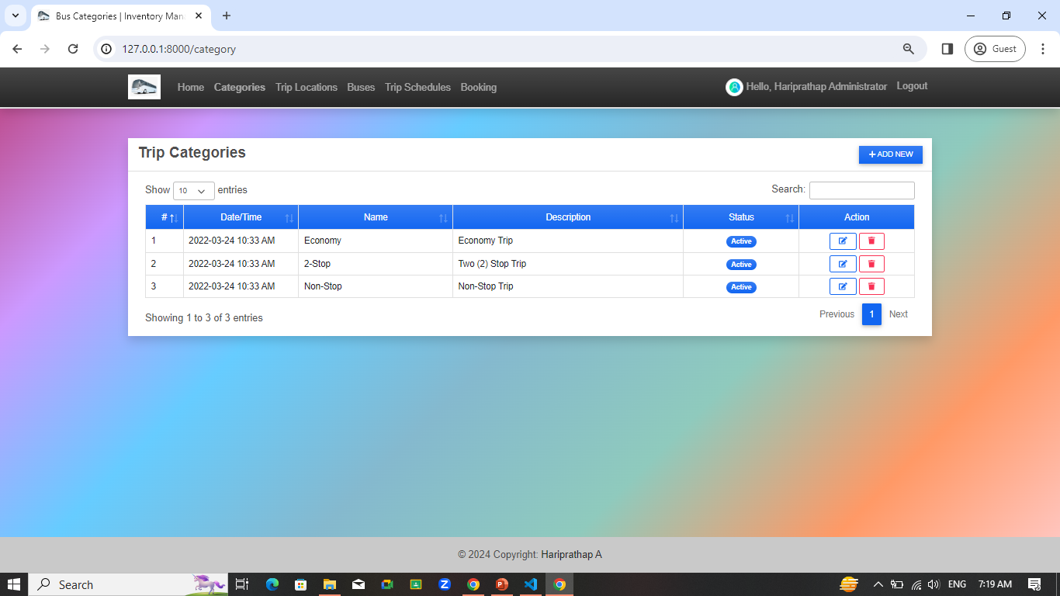
Departments-Page

Slide 14
Blog-Page

Slide 15
Future Enhancements:
Mobile Application Development: Expand SwiftRide's reach by developing mobile applications for iOS and Android platforms. This will provide users with additional flexibility and convenience, allowing them to book bus tickets on the go.
Integration with Travel Services: Partner with other travel services such as hotels, car rentals, and tour operators to offer bundled packages and seamless travel experiences. Integration with these services will enhance SwiftRide's value proposition and attract more users.
Dynamic Pricing and Offers: Implement dynamic pricing algorithms based on factors such as demand, time of booking, and seat availability. Additionally, introduce special offers, discounts, and loyalty programs to incentivize repeat bookings and increase customer retention.
Integration with Public Transport Systems: Collaborate with public transport authorities to integrate SwiftRide with existing public transport systems. This will provide users with a seamless multimodal travel experience and promote sustainable transportation options.
Localization and Internationalization: Expand SwiftRide's reach to global markets by adding support for multiple languages and currencies. Localization and internationalization efforts will cater to diverse user demographics and facilitate expansion into new regions.
Social Media Integration: Integrate SwiftRide with popular social media platforms to enable users to share their travel experiences, reviews, and recommendations. Leverage social media integration to increase brand visibility, engage with users, and attract new customers.

Slide 16
Conclusion
In conclusion, SwiftRide represents a significant advancement in the realm of online bus ticket reservation systems, leveraging the power of Python and the Django framework to deliver a modern, efficient, and user-friendly platform for travelers. Throughout the development process, we have successfully addressed the challenges faced by existing systems and introduced innovative features and functionalities to enhance the booking experience.
SwiftRide offers users a seamless and convenient way to book bus tickets, with features such as real-time availability updates, flexible payment options, interactive seat selection, and instant confirmation of bookings. The system prioritizes user security and data integrity, ensuring that user information remains protected at all times.
Looking ahead, SwiftRide has the potential for further expansion and enhancement through future development efforts. By embracing mobile application development, integration with travel services, dynamic pricing strategies, and advanced analytics capabilities, SwiftRide can continue to evolve and meet the changing needs of travelers.
Overall, SwiftRide represents a paradigm shift in the online bus ticket reservation industry, setting a new standard for efficiency, convenience, and reliability. With its user-centric design, robust backend architecture, and commitment to continuous improvement, SwiftRide is poised to become the preferred choice for travelers seeking hassle-free and enjoyable journeys.
Source : Python and Django Documentation

Slide 17
Thank You!
Notes:
Thank You !!

